Slide 1
IMAGE PROCESSING

Slide 2
Introduction
-> An image can be represented as a matrix of pixels
-> Each pixel is expressed as a 3D vector
-> Composed by the amount of red, green and blue
of the color.

Slide 3
SHADES TINTS AND HUES

Slide 4
-> Filters are applied to each pixel of the matrix using
the filter function
-> Filter function - basically matrix addition, subtraction
and multiplication
-> The input of this function can be just a pixel
-> Each pixel has values from 0–255
-> Different combination of RGB produce different
Colors - colour filters
-> Photography filters

Slide 5

BEFORE IMAGE

Slide 6

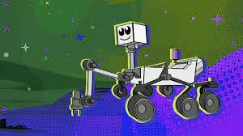



Slide 7
GRAYSCALING

Slide 8
->The components of each new pixel- obtained by
calculating the average of the three components
-> Value of each pixel represents only the intensity
information of the light.
-> Such images typically display only the darkest black
to the brightest white.
-> Image contains only black, white, and gray colors, in
which gray has multiple levels.

Slide 9
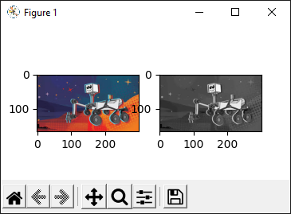
BEFORE AND AFTER IMAGE

Slide 10
IMAGE RECONSTRUCTION USING SVD

Slide 11
->Image reconstruction is a technique deployed to reconstruct the image approximately towards the original image
->It uses the concept of Singular value decomposition i.e we detect the top 2 singular vectors and use them for reconstruction
->We can reconstruct SVD of an image by using linalg.svd() method of NumPy module.
->With the help of singular values you can reconstruct a image

Slide 12
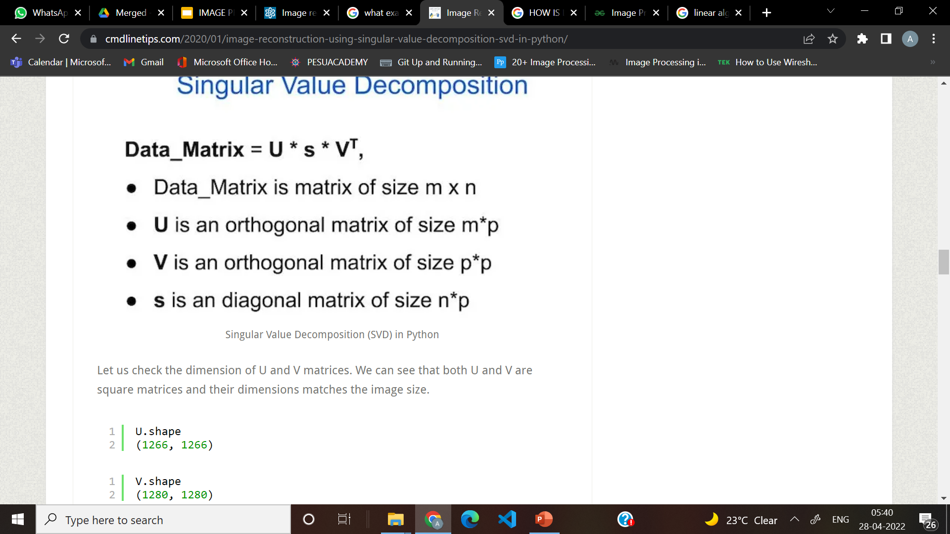

Slide 13
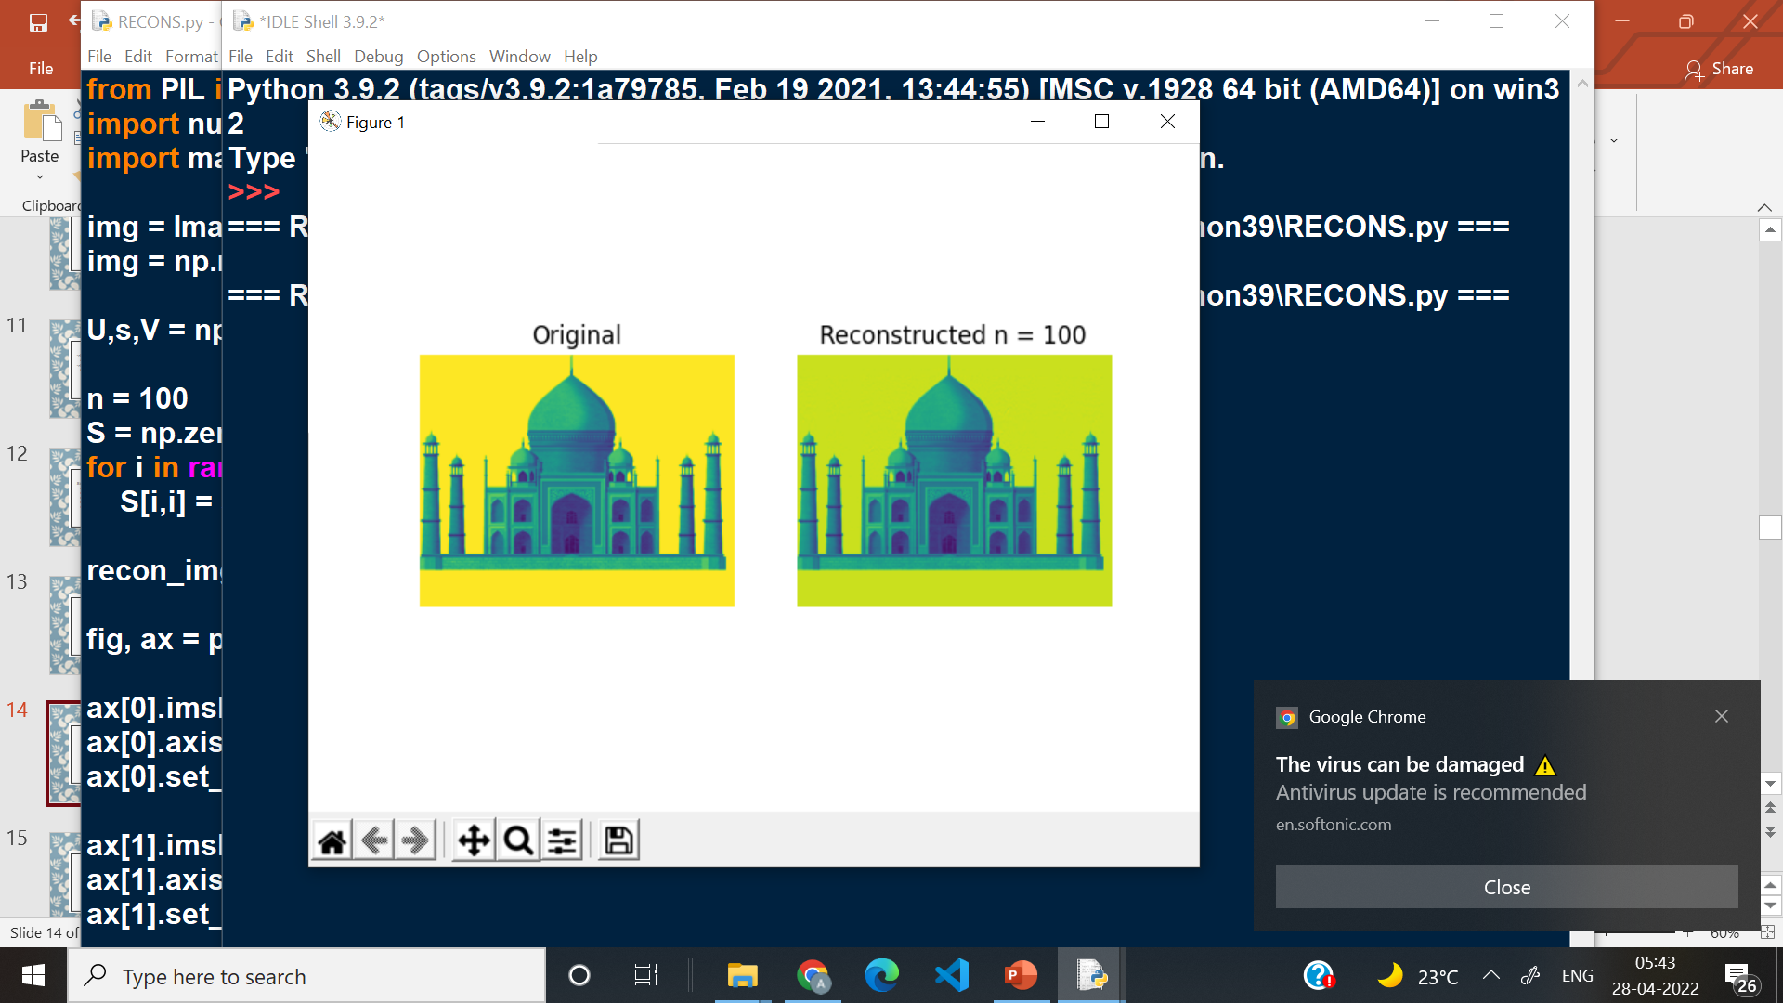

Slide 14
SHEARING

Slide 15
->Shear mapping is a linear map that displaces each point in fixed direction, it substitutes every point horizontally or vertically by a specific value in proportional to its x or y coordinates.
->There are two types of shearing effects
->Shearing in x-direction
->When shearing is done in the x-axis direction, the boundaries of the image that are parallel to the x-axis keep their location, and the edges parallel to y-axis changes their place depending on the shearing factor.
->Shearing in y-direction
->When shearing is done in the y-axis direction, the boundaries of the image that are parallel to the y-axis keep their location, and the edges parallel to x-axis changes their place depending on the shearing factor.

Slide 16
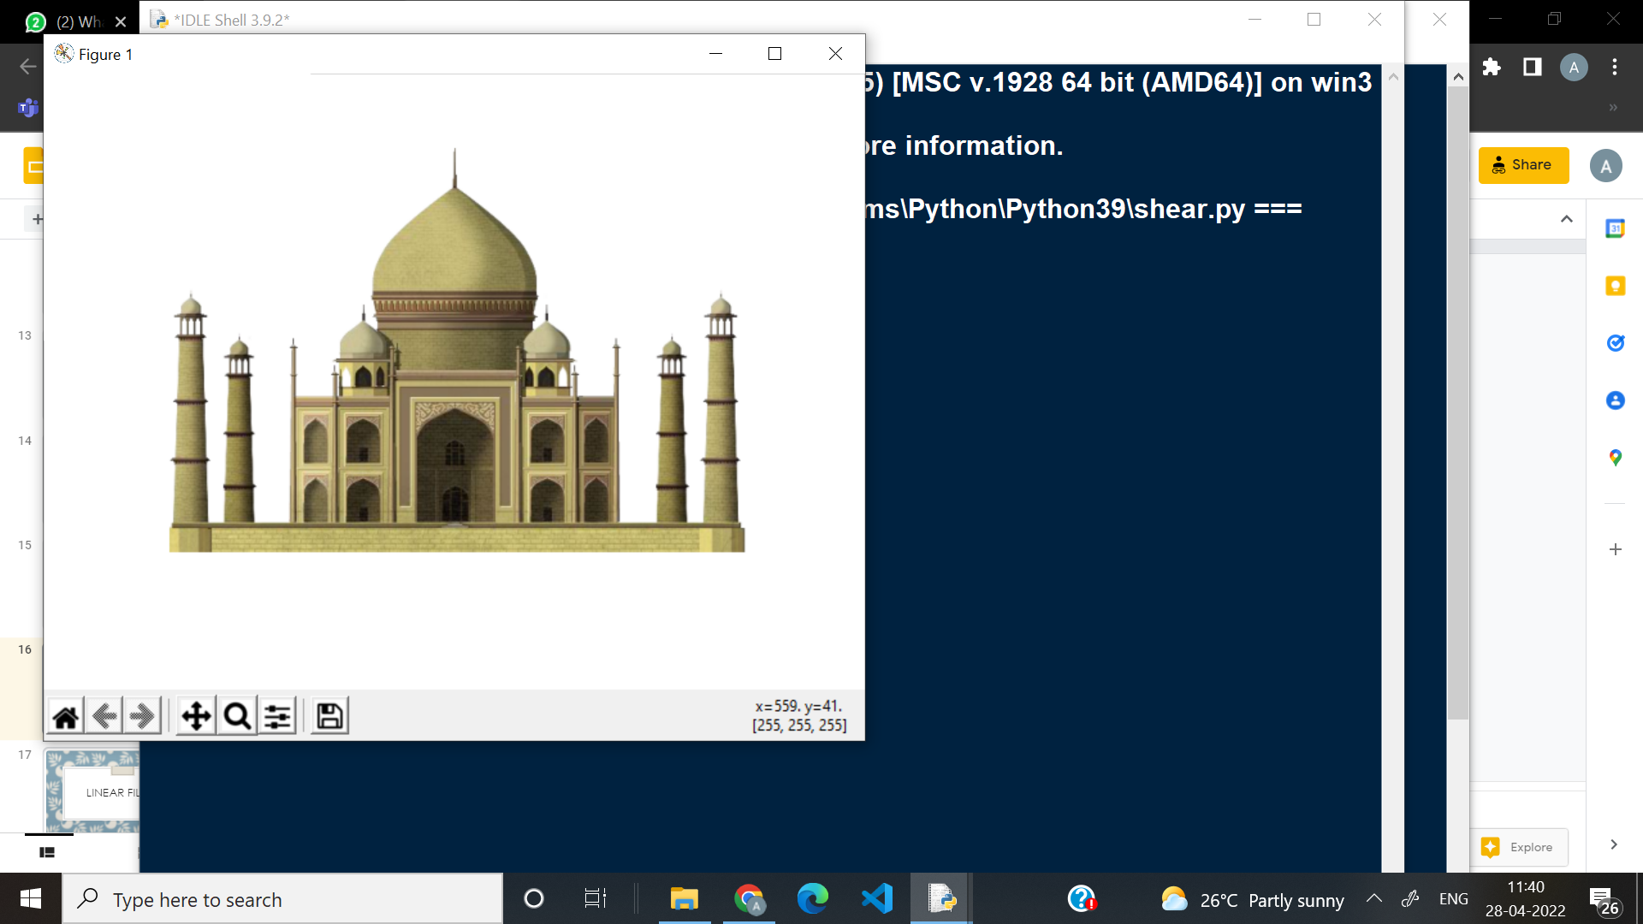
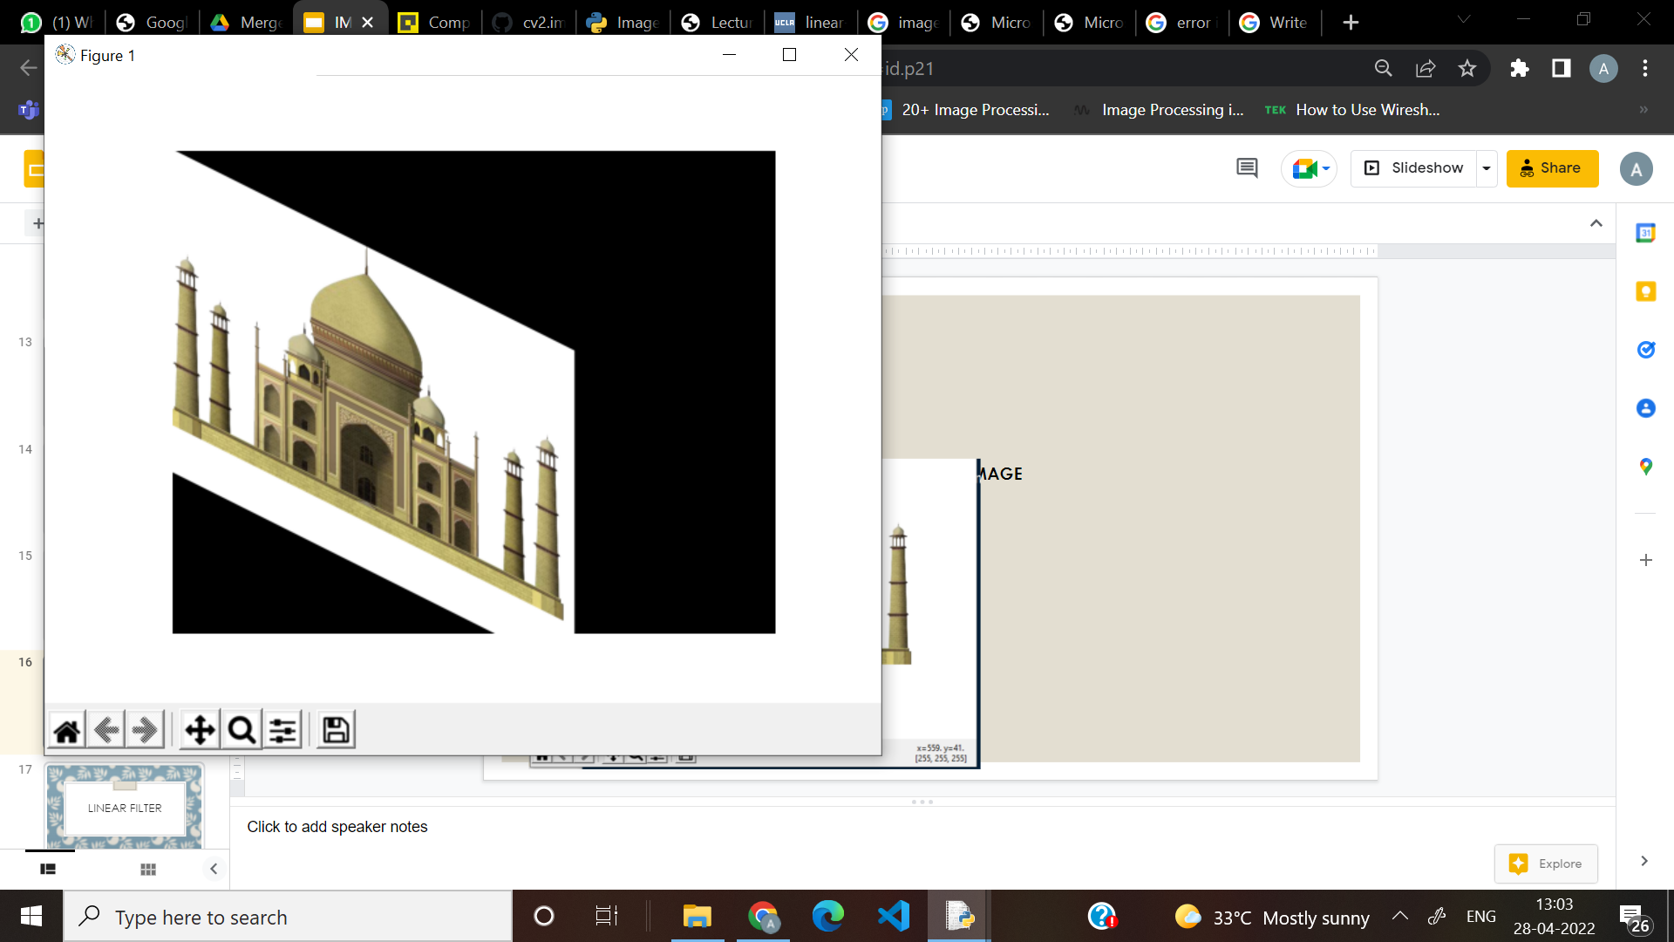
ORIGINAL IMAGE IMAGE AFTER TRANSFORMATION
TRANSFORMATION

Slide 17
LINEAR FILTER

Slide 18
Linear Filter: Introduction
•These process time-varying input signals to produce output signals, subject to the constraint of linearity.
•It is a filtering in which the value of an output pixel is a linear combination of the values of the input pixel's neighborhood.
•The concept used here is convolution in 2 dimension.[ie,It uses a 2D matrix]
•Applications: Generic tasks such as image/video contrast improvement, denoising, sharpening, and feature enhancement.

Slide 19
Linear Filter: Working
The code works in the following way:
1.It first loads the original image and initializes the variable (ddepth).
2.Then we define the kernel .
3.This can be done by defining Kernel size.
4. Filling the kernel with 1’s and normalizing it.
5.Then we use the source image and Kernel to get output.
6.The output is that every 1 second the kernel size of this filter will be updated.

Slide 20
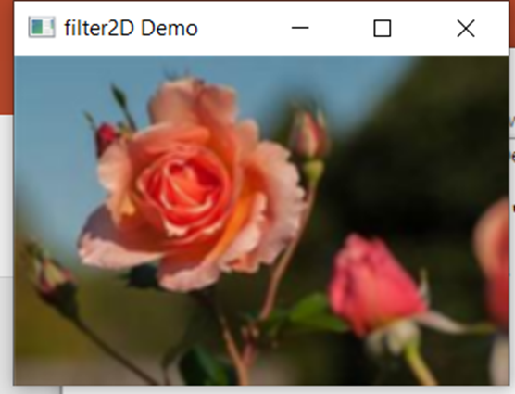
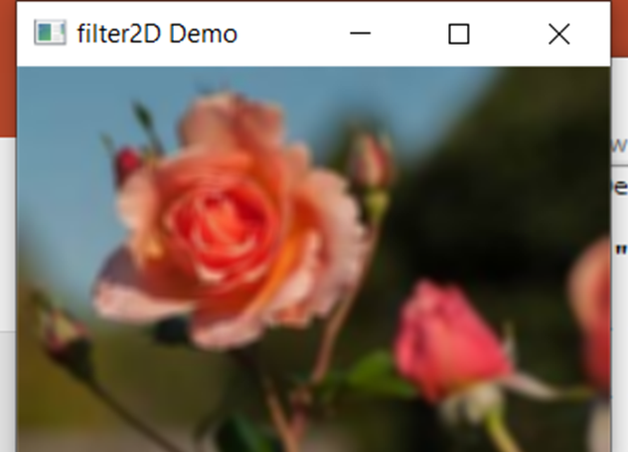
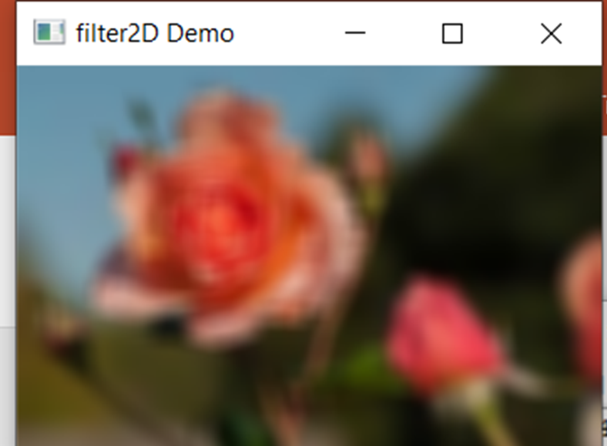
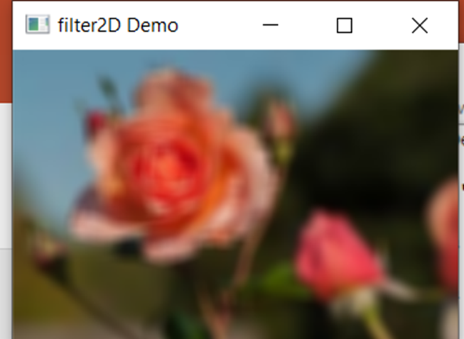
Linear Filter: Input and Output

Slide 21
RESIZING

Slide 22
Resizing an Image: Introduction
•It is the process of changing the scale of a discrete or continuous image by way of resolution. The whole image is present after applying resizing.
•The concept used here is, if we want to resize an image, we shall have to change its ‘pixel information’. [This is done with the help of matrices]
•Applications: transliteration of the image, correcting for lens distortion, changing perspective, and rotating a picture.

Slide 23
Resizing an Image: Working
The code works in the following way:
1.It first loads the original image and initializes the variables (x and y).
2.Then we assign 3 variables[blue plane, green plane, red plane.
3.Each variable has the specific plane value, which is got from that specific plane value of the blue-green-red image.
4.It take 1/x pixels of the row & 1/y pixels of the column for each value.
5.Then we create a zero matrix for the resized image variable.
6.Assigning the new ‘blue plane’, ‘red plane’ and ‘green plane’ values to get the resized image and displaying the same.

Slide 24
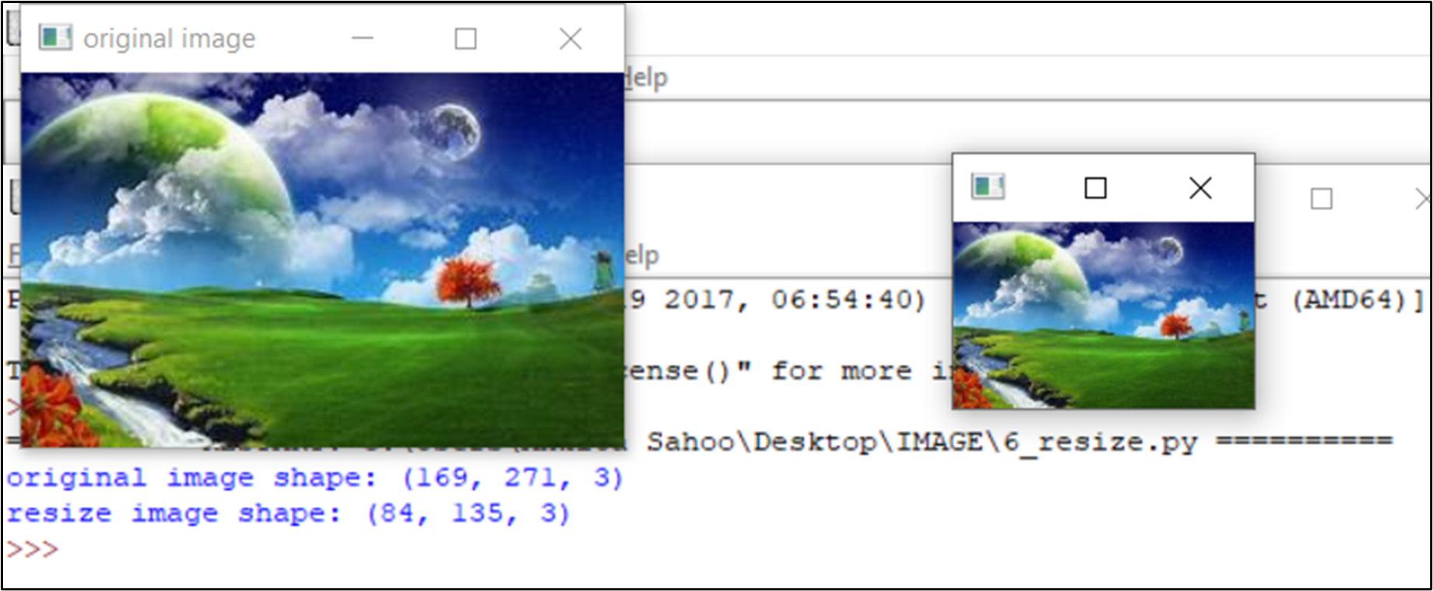
Resizing an Image: Input and Output

Slide 25
ROTATION

Slide 26
Rotation : Introduction
->Implementation of a rotation filter on an image that rotates the image around its center by the specified degrees .
->Uses the concept of linear transformation particularly
rotation to fill in intensity values for the coordinates required
->We first find the height and width of the rotated image followed by finding the center point coordinates of both original as well as rotated image. Then we create a rotated image with appropriate height and width

Slide 27
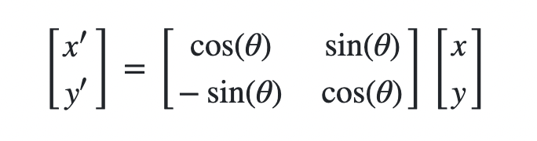
Linear transformation used
Where theta is the angle to be rotated

Slide 28



ROTATED
IMAGE(180)
ROTATED
IMAGE(45)
ORIGINAL IMAGE

Slide 29
GAUSSIAN FILTER

Slide 30
->Implementation of a Gaussian filter/kernel to smooth/blur an image .
->Typically to reduce image noise and reduce detail using the Gaussian function.
->We implement it in 2 parts:
Creating a Gaussian Kernel that is a mask or a small matrix for performing operations such as blurring in this case.
Performing Convolution i.e. transforming an image by applying a kernel over each pixel and its local neighbors across the entire image.

Slide 31
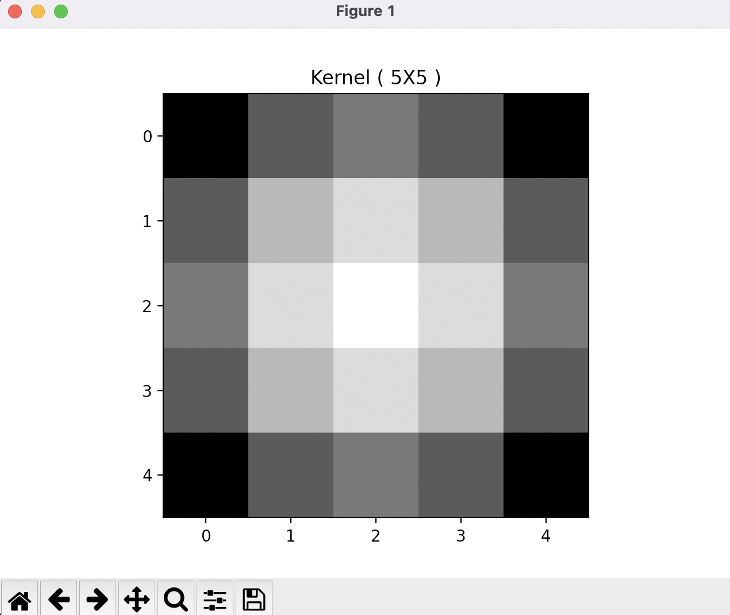
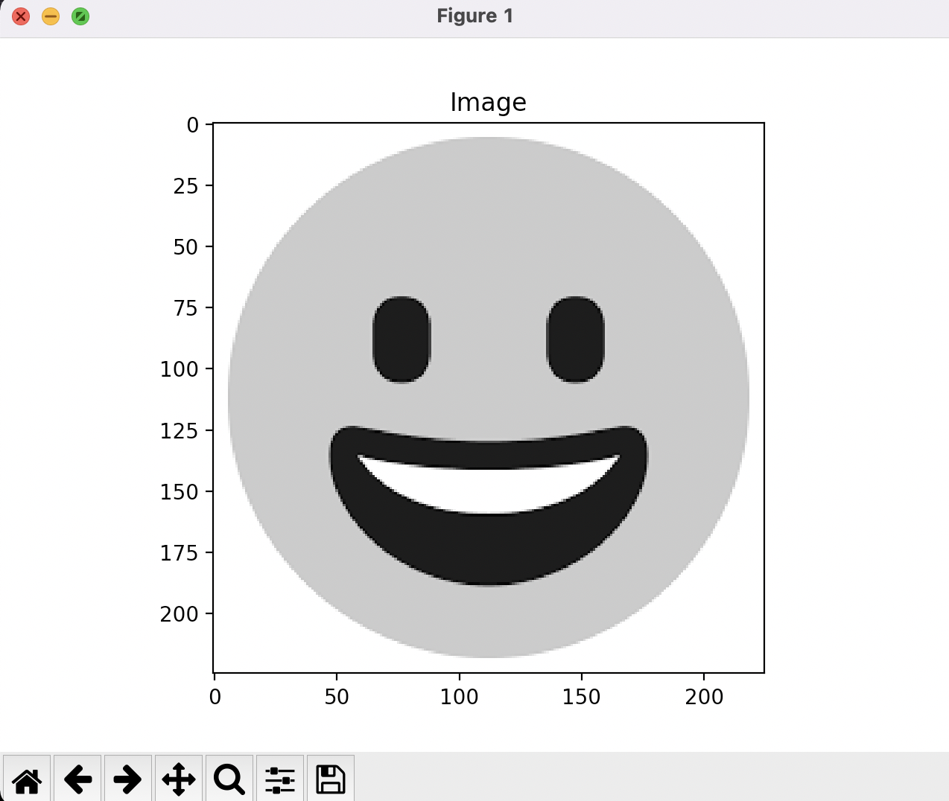
KERNEL IMAGE GRAYSCALE
(BGR TO GRAY AS CONVOLUTION TAKES ONLY ONE CHANNEL)
(KERNEL 5X5)

Slide 32
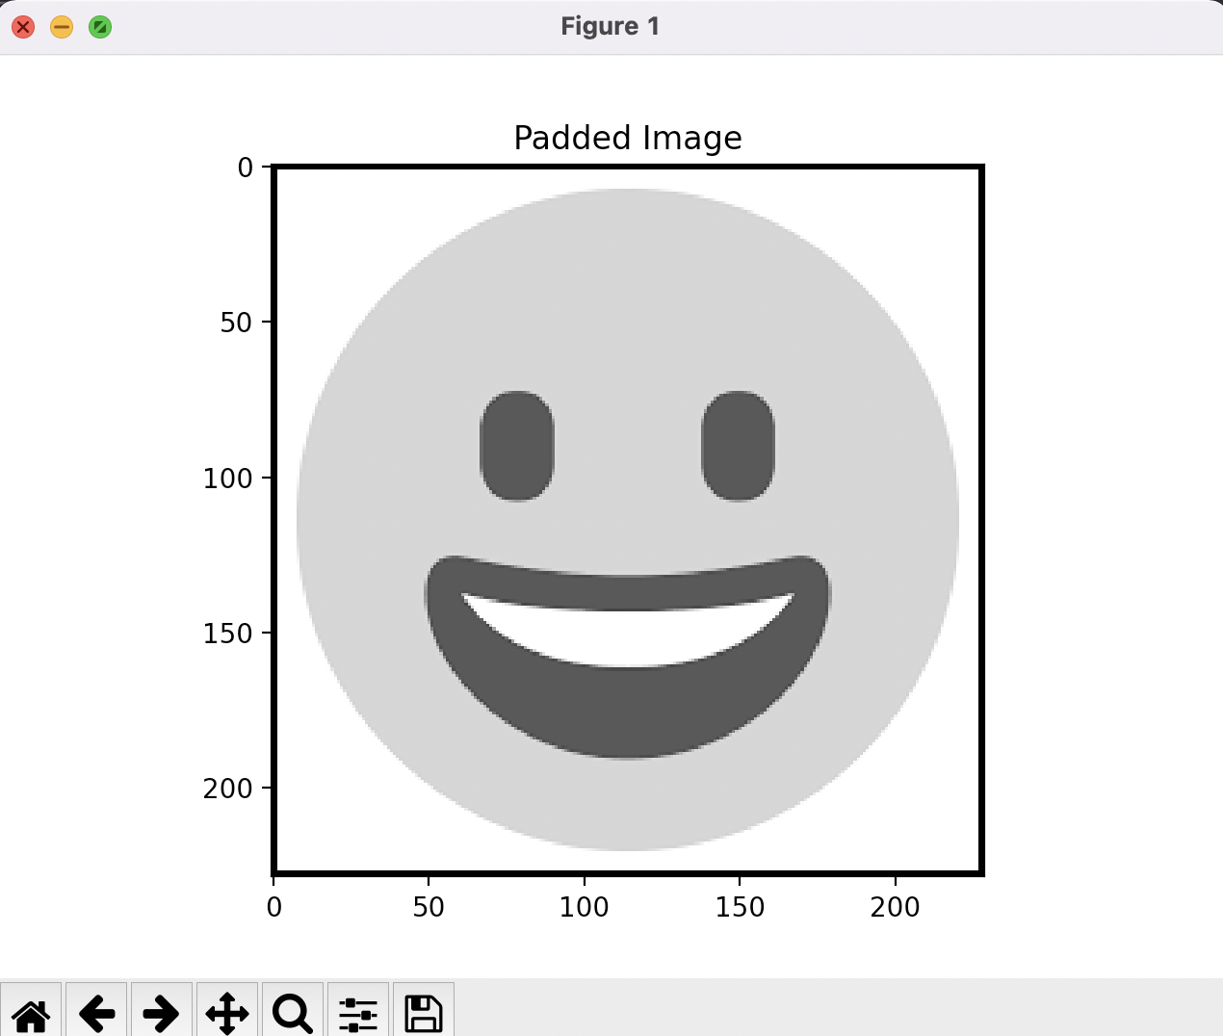
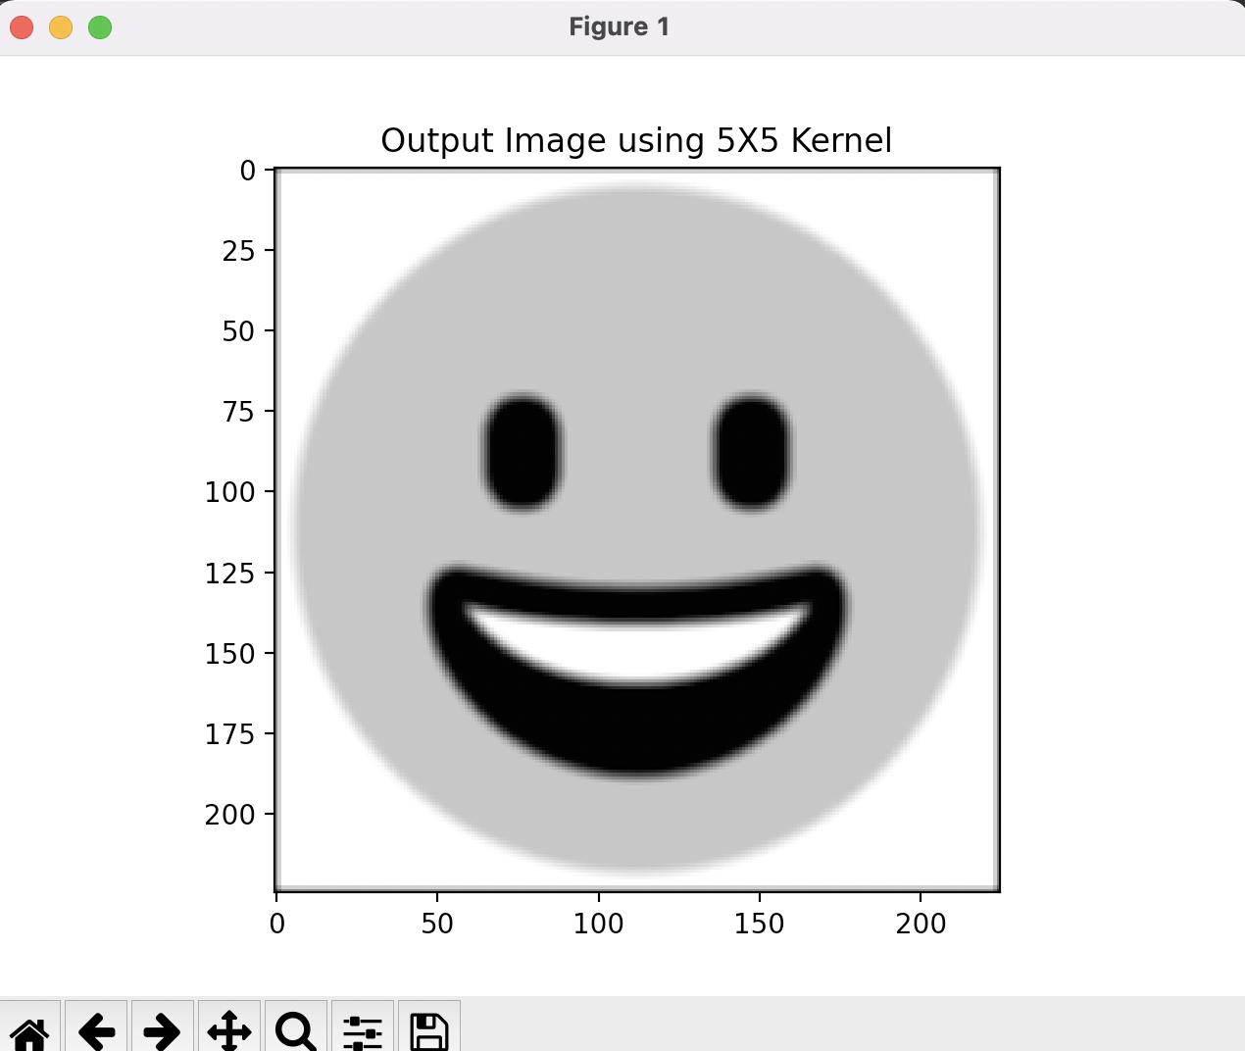
PADDED IMAGE FINAL IMAGE
(USES ZERO PADDING:adding rectangular strips of zeros outside the rectangular edge
(USING 5X5 KERNEL)

Slide 33
MEDIAN FILTER

Slide 34
MEDIAN FILTER
The Median Filter in Image Processing is normally used to reduce noise in an image, somewhat like the mean filter. However, it often does a better job than the mean filter of preserving useful detail in the image.
Median Filter is a simple and powerful non-linear filter.
It is used for reducing the amount of intensity variation between one pixel and the other pixel.
In this filter, we replace pixel value with the median value.
The median is calculated by first sorting all the pixel values into ascending order and then replace the pixel being calculated with the middle pixel value
Reduces salt and pepper noise

Slide 35
Working of Median Filter:
The median filter considers each pixel in the image in turn and looks at its nearby neighbour to decide whether or not it is representative of its surroundings. Replacing the pixel value with the median of those values.
The median is calculated by first sorting all the pixel values from the surrounding neighborhood into numerical order and then replacing the pixel being considered with the middle pixel value. (If the neighborhood under consideration contains an even number of pixels, the average of the two middle pixel values is used)

Slide 36
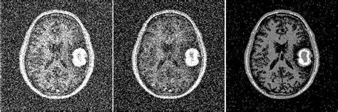
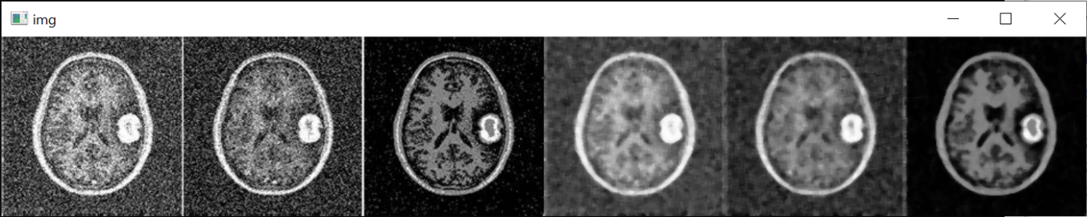
BEFORE APPLYING FILTER:
AFTER APPLYING FILTER:

Slide 37
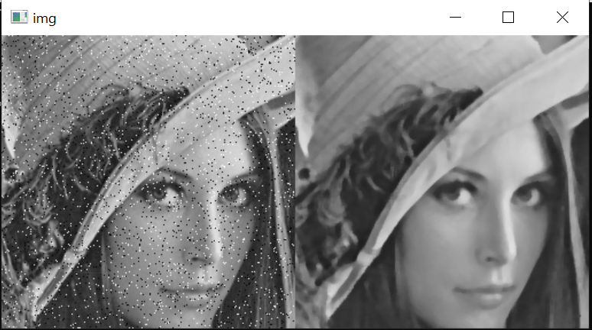
BEFORE AFTER

Slide 38
Scaling Transformations:
The scale operator performs a geometric transformation which can be used to shrink or zoom the size of an image (or part of an image). Image reduction, commonly known as subsampling, is performed by replacement (of a group of by pixel values one arbitrarily chosen pixel value from within this group) or by interpolating between pixel values in a local neighborhoods.
Image zooming is achieved by pixel replication or by interpolation. Scaling is used to change the visual appearance of an image, to alter the quantity of information stored in a scene representation, or as a low-level preprocessor in multi-stage image processing chain which operates on features of a particular scale. Scaling is a special case of affine transformation.

Slide 39
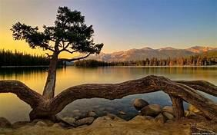

BEFORE AFTER

Slide 40
THANK YOU

